Slide 1
PLANNING for STATISTICAL ANALYSIS
MASTER OF PUBLIC HEALTH PROGRAM
STAT 7311 - BIOSTATISTICS
LECTURE 2
Muhammad Adil Zainal Abidin
“Statistics is the grammar of science” Karl Pearson
(1857 – 1936, influential English mathematician)

Slide 2
TOPIC LEARNING OUTCOME
Planning and produce a statistical analysis plan (SAP)
Planning and construct dummy table

Slide 3
STATISTICAL ANALYSIS PLAN (SAP)
A SAP expands on the analysis section of a protocol or proposal.
Providing detailed explanations of planned analyses and technical information such as how protocol deviations and missing data will be handled in analysis.
The level of detail required should allow for analysis to be replicated by another analyst.
The plan is finalised before the final outcome data is received

Slide 4
WHY SAP
Developing a SAP is good practice and is beneficial, standard reporting practice
Thinking analyses through before they are conducted can help ensure they are appropriate for the context
Pre-specifying analyses minimises bias and adds validity as analyses are not data driven NOT FISHING, MINIMISE BIAS

Slide 5
WHY SAP - continued
Potential analysis pitfalls may be identified which could help plan an approach to avoid these if possible - AVOID PROBLEM IN ANALYSIS
Other analysts benefit if hand-over occurs or if analyses need to be recreated - REPRODUCIBILITY AND TRANSPARENCY

Slide 6
EXAMPLE SAP
Setting the scene | Restate the study objectives Detail the study design Reproduce the sample size calculation & justify Detail the method of randomisation including allocation ratio and any factors use Is data analyst or statistician blinded Variable level of measurement, data transformation, data wrangling
Description of outcomes | Define the primary outcome Define any secondary outcome(s) State when will the outcomes be measured including the interim analysis if plan Justify why these outcomes were chosen

Slide 7
EXAMPLE SAP CONTINUED
Analysis | Specify the analysis data set (e.g. ITT, PP) State the software package to be used for analysis Detail methods for handling missing data & protocol deviations Assessing the data distribution How the assumptions of the statistical test will be tested State the significance level to be employed, one or two tailed Include blanket statements relating to confidence intervals & effect sizes etc. Explain how baseline data will be handled Detail the methods proposed for primary, secondary, subgroup and secondary analysis Selection of the post hoc test

Slide 8
SET OBJECTIVES AND HYPOTHESIS
Set the statistical hypothesis for each objectives - this set the alpha either one or two sided
Planned the analysis for each of the objectives

Slide 9
CONCEPTUAL FRAMEWORK - PLAN THE STATISTICAL TEST
What is the conceptual framework
Existing knowledge relationship between variables and analysis to be tested
What is the confounder - to plan for control confounding
What is the moderator - to plan for interaction analysis
Is there mediator ? - partial or full mediator
What is the outcome variables, can be measured directly or indirectly (primary or secondary outcomes analysis.

Slide 10
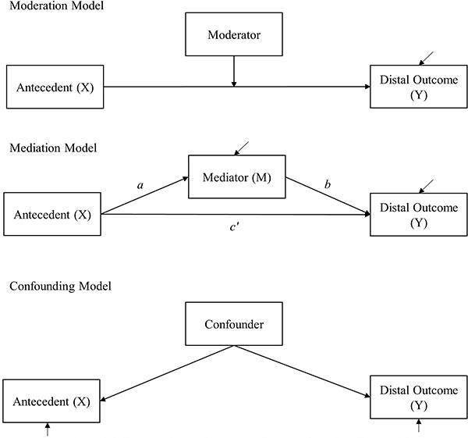

Slide 11
SELF STUDY
DAG for conceptual framework how to assign DV, IV, Confounder, moderator and mediator

Slide 12
SAMPLING AND SAMPLE SIZE
Plan your data collection sampling method - random
Assumption of statistical sometimes require data are independent observations
Sample size calculated powered for your analysis and hypothesis
Anticipating non-response, attrition rate, loss to follow up, missing data, missing variable, missing outcome, missing baseline level.
If plan for interim analysis, when, and what is the sample size for interim and the alpha spending. Method ?

Slide 13
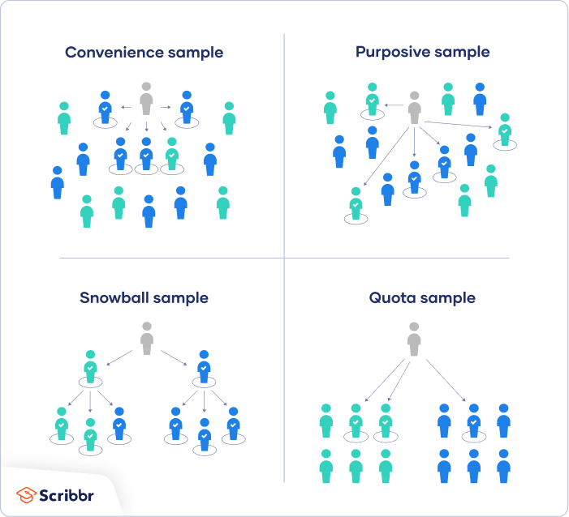
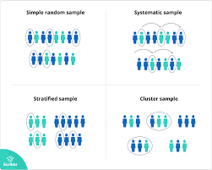
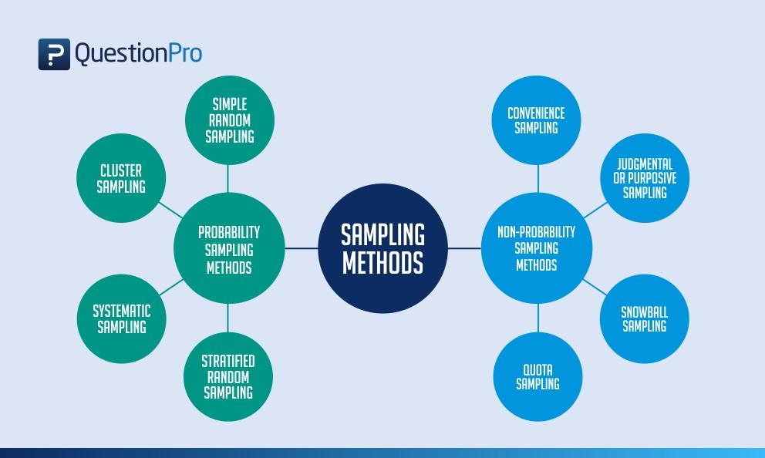
SAMPLING TECHNIQUE
Sampling technique
Probability sampling technique
Non-probability sampling technique
Representative of population
"Statistics are the heart of democracy."
Simeon Strunsky

Slide 14
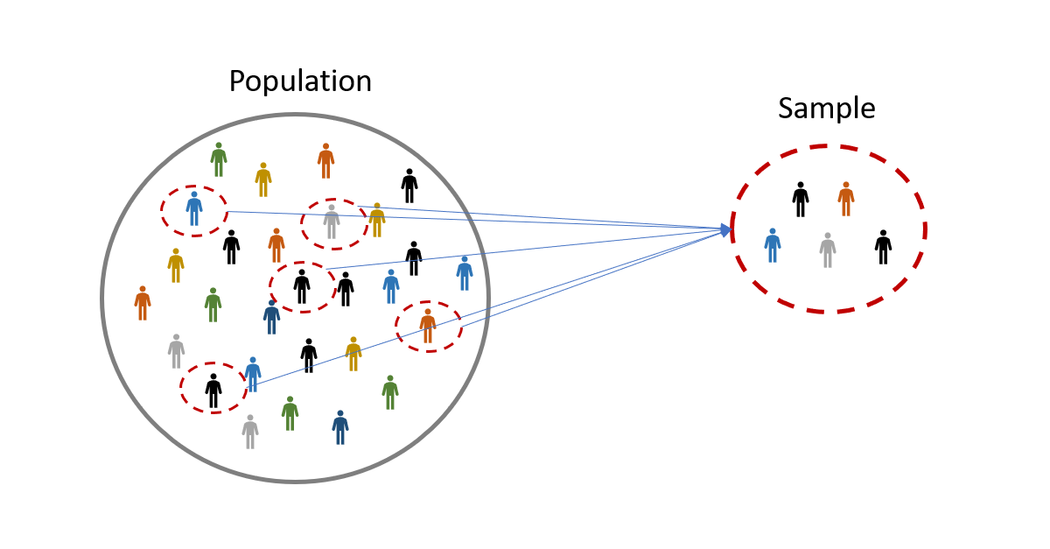
SAMPLE SIZE
Essential in almost all research
Not restricted for all research
Depends on main research objectives
Should select the highest number of sample size to cater all objectives
It is only ESTIMATE, calculated from previous study or from our expectation.
It is the minimum sample size required to test the statistical hypothesis

Slide 15
FACTOR DETERMINING SAMPLE SIZE
6. Design effect (deff)
7. Number of strata
8. Adjustment for estimated
response rate/loss to follow up
9. Adjustment for confounding and
interaction
10. Adjustment for clustered design
11. Unequal groups size
12. Two tail vs one tail test
1.Based on objective/hypothesis either
1.1 Aim to demonstrate a specified difference
1.2 Aim to estimate a quantity of interest
with a specified precision level (d)
2. Level of significance
3. Standard deviation
4. Expected effect size
5. Power

Slide 16
DATA DISCRETIZATION OR BINNING - VARIABLE LEVEL OF MEASUREMENT
From continuous to categorical
To get significant findings or small observation
Loss of information, less power including the test used
Spurious discontinuity - artificial and misleading boundaries with real concept
Residual confounding - the effect partially removed in categorical data
Misinterpretation of the effect, U shape quadratic effect
Unreliable cut off points - researcher conveniently use, not replicable
Always use domain knowledge for categorization
Have more than 2 category
PRE PLAN!

Slide 17
Levels of measurement
Measurement
Categorical
Numerical
Nominal
Ordinal
Discrete
Continuous
Gender
Staging of cancer
Number of household members
Temperature

Slide 18
PLAN FOR SOFTWARE
Which software for data collection, manipulation, entering, and analysis
Which version and packages use

Slide 19
HOW TO MANAGE DATA
Raw data
Plan for data collection - Data dictionary and coding
Plan for data format - Long or wide format
Plan for data blinding and data confidentiality
Plan for data quality (Data entry)
Data trail - REDCap

Slide 20
PLAN FOR ANALYSIS - SELECTING APPROPRIATE TEST
Data distribution , how assessed
How baseline data analyses
Select appropriate test for the research hypothesis
Check for the statistical test assumptions and the method
Data analysis process for check for confounding
Data analysis for moderating, check for main effect and interaction effect
Data analysis for modelling, method and p value used
Interim analysis, sample size for each interim and alpha spending
Post hoc test selection and justification
Measure of effect used, OR/RR/HR/Effect size and what is the interpretation guideline used

Slide 21
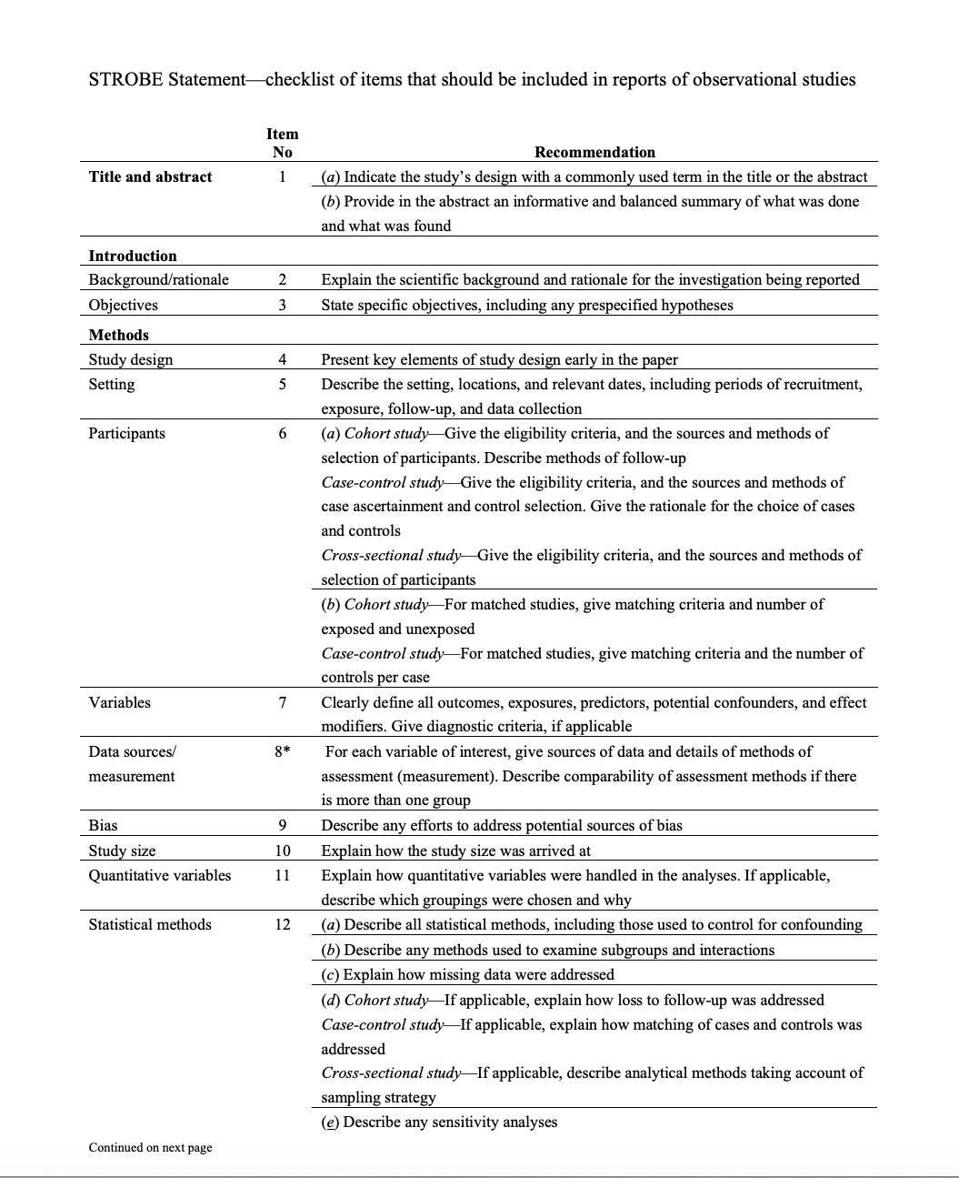
EQUATOR Guideline on statistical analysis plan
Observational studies

Slide 22
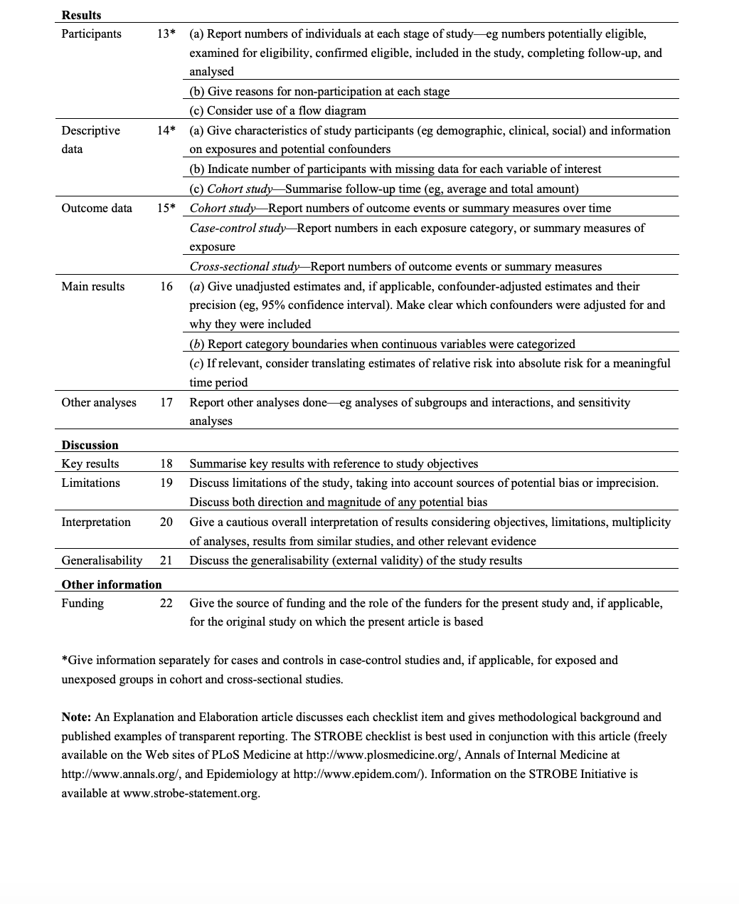
EQUATOR Guideline on statistical analysis plan
Observational studies

Slide 23
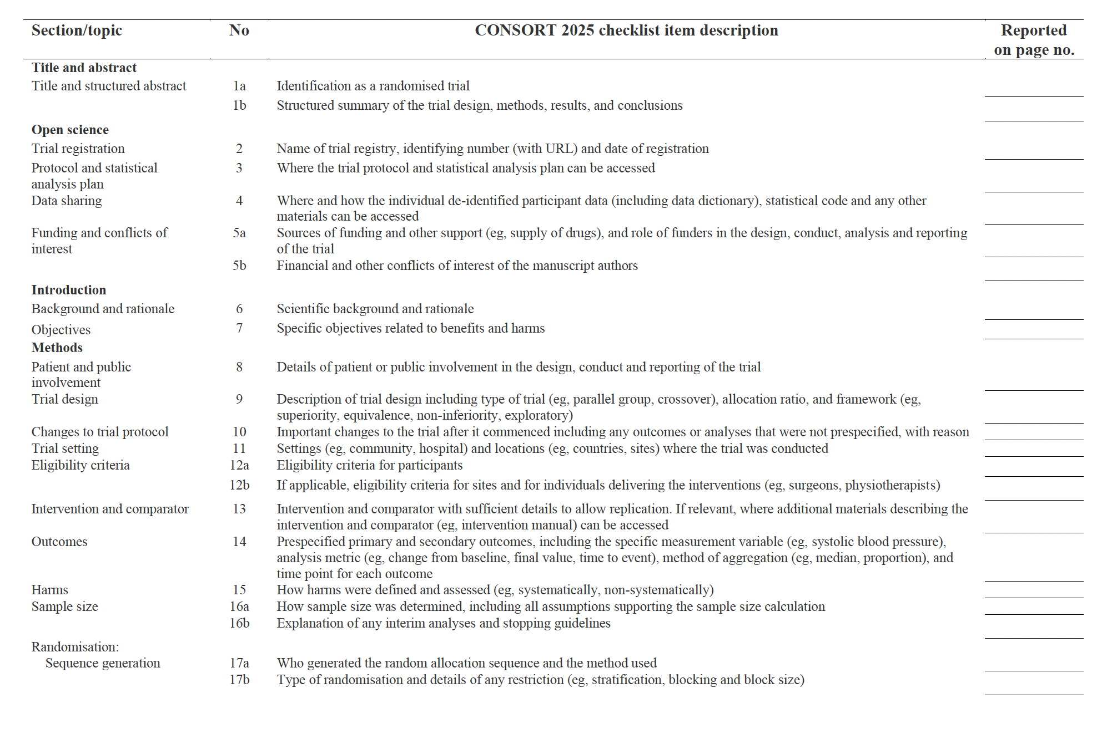
EQUATOR Guideline on statistical analysis plan - Intervention

Slide 24
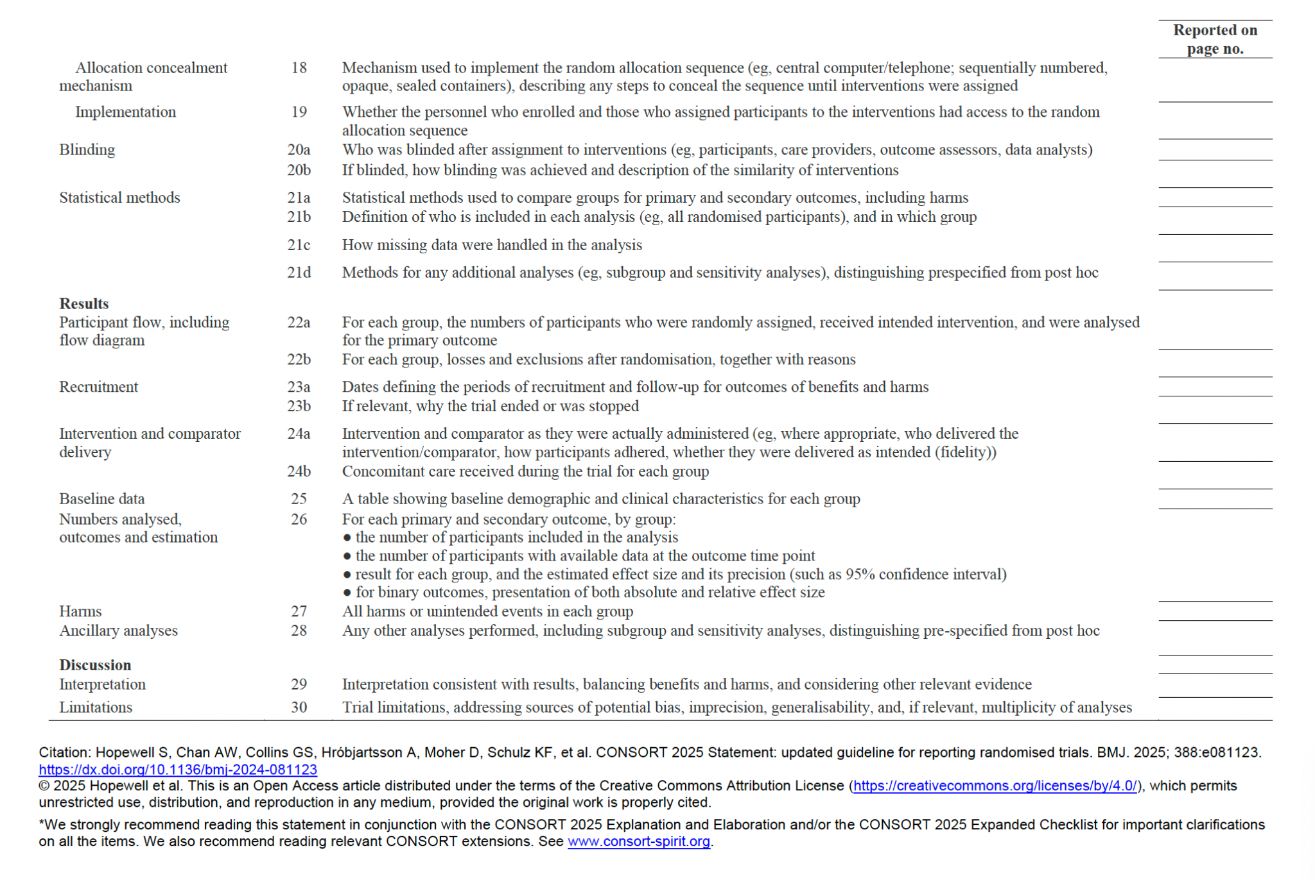
EQUATOR Guideline on statistical analysis plan - Intervention

Slide 25
EQUATOR Guideline on statistical analysis plan - Others
PRISMA - Systematic review
STARD - Diagnostic / prognostic study

Slide 26
PLANNING AND CONSTRUCT DUMMY TABLE / FIGURES
IIUM Guideline for the table and figure formatting
APA 7TH Edition Formatting for the statistical reporting

Slide 27
What is dummy table or dummy figure
Pre specified result table or figure with the designated variables , statistical test used and pre specified analysis
Empty cells
In order of research objectives

Slide 28
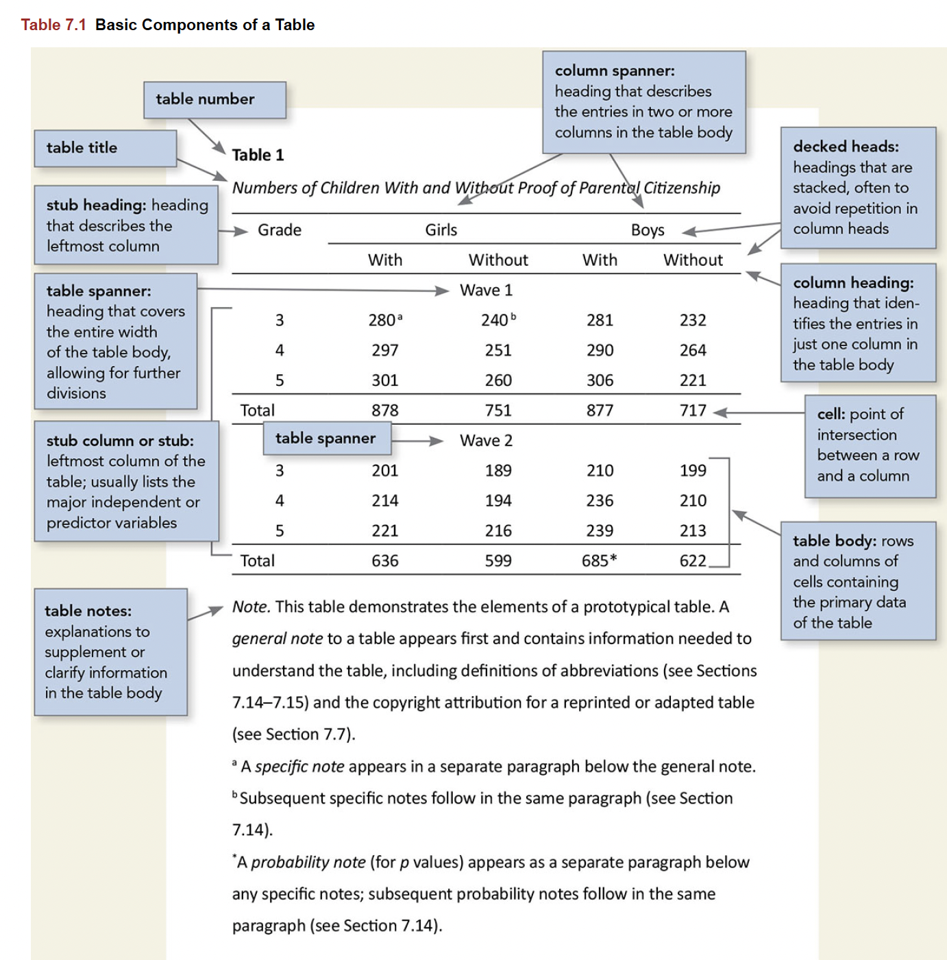
TABLE ANATOMY

Slide 29
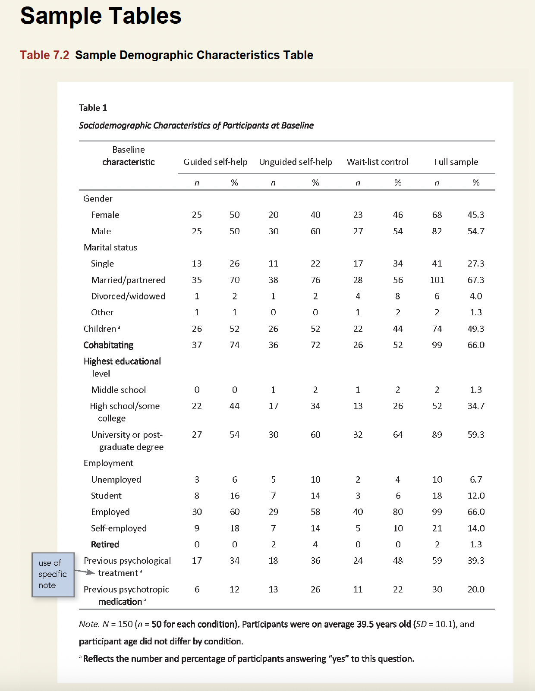
General Table
Outcome or DV in column
Column percentages
Not row percentages
Capital N for total sample
Small n for sub sample

Slide 30
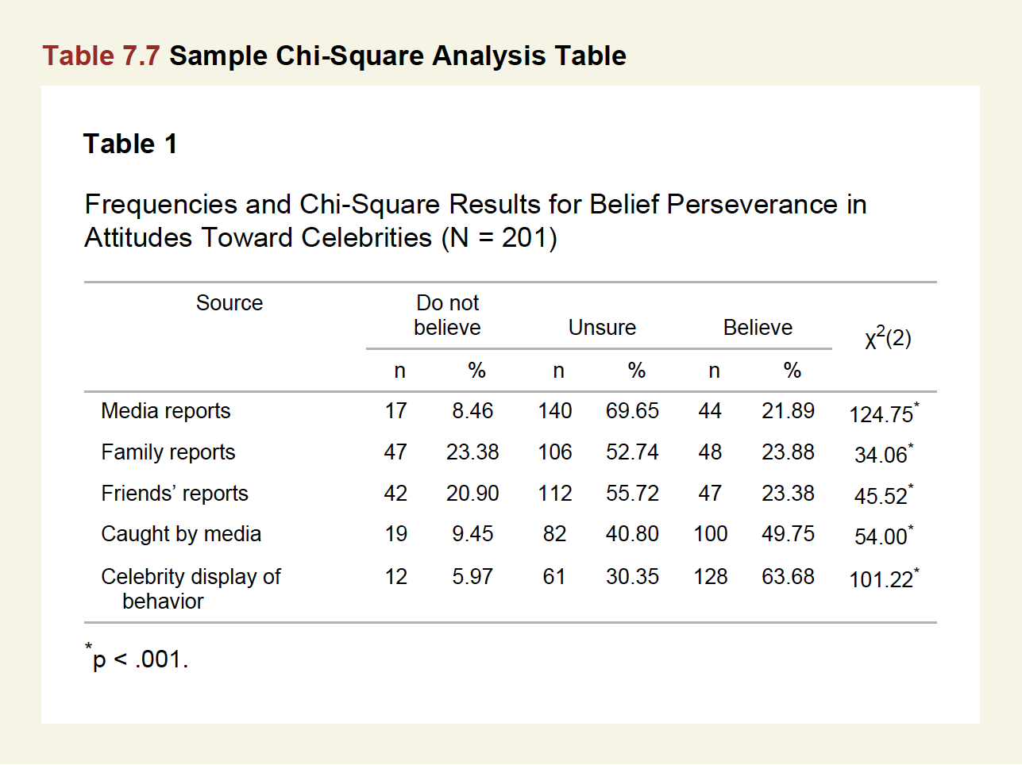
Chi square table
Chi square with degree of freedom
Table footnote for significant findings
Column or row % ?
Cross sectional - Row % with row IV
Cohort - Row % with row exposure
Case control - Column % with column outcome
Intervention - Column % with column of arm

Slide 31
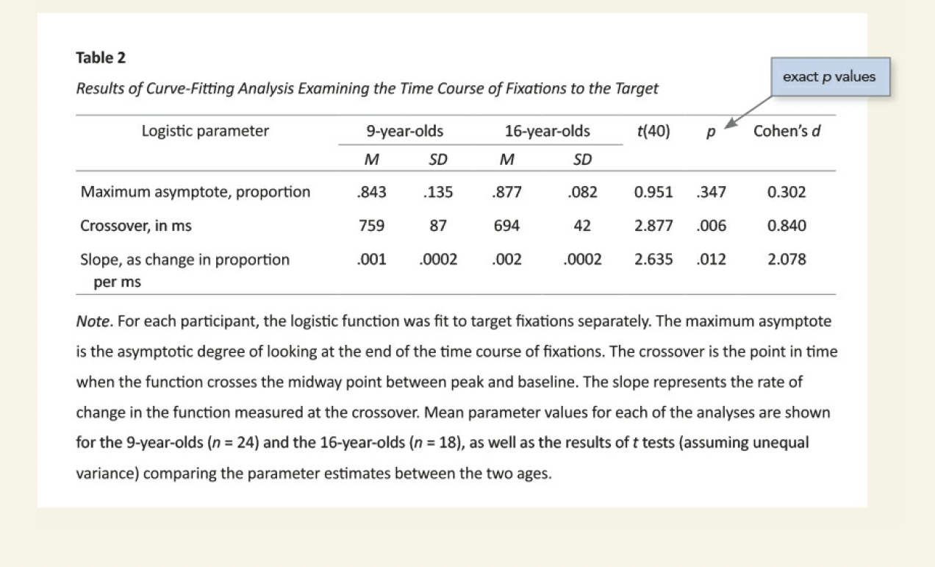
t test table
t statistic
degree of freedom
p value
Effect size

Slide 32
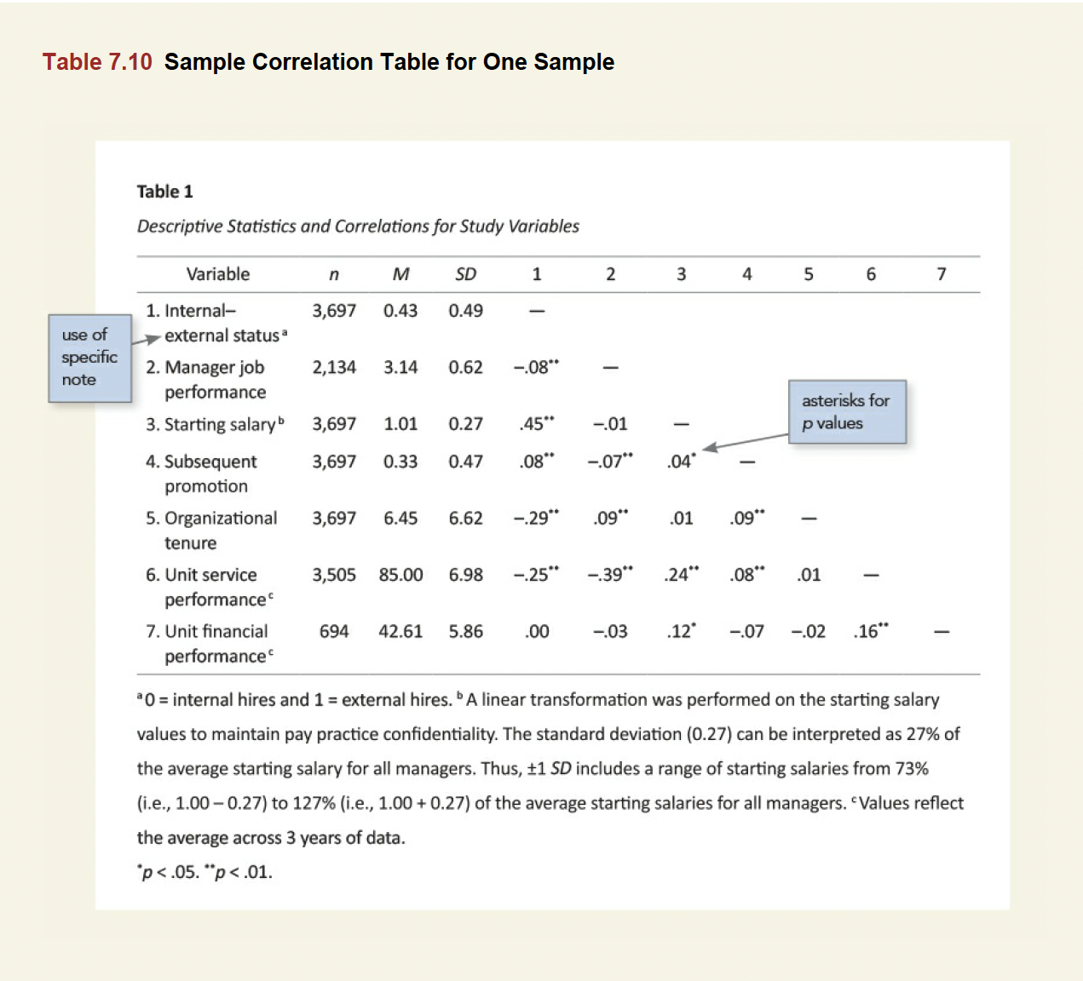
Correlation test
Correlation coefficient
Table footnote for sig finding

Slide 33
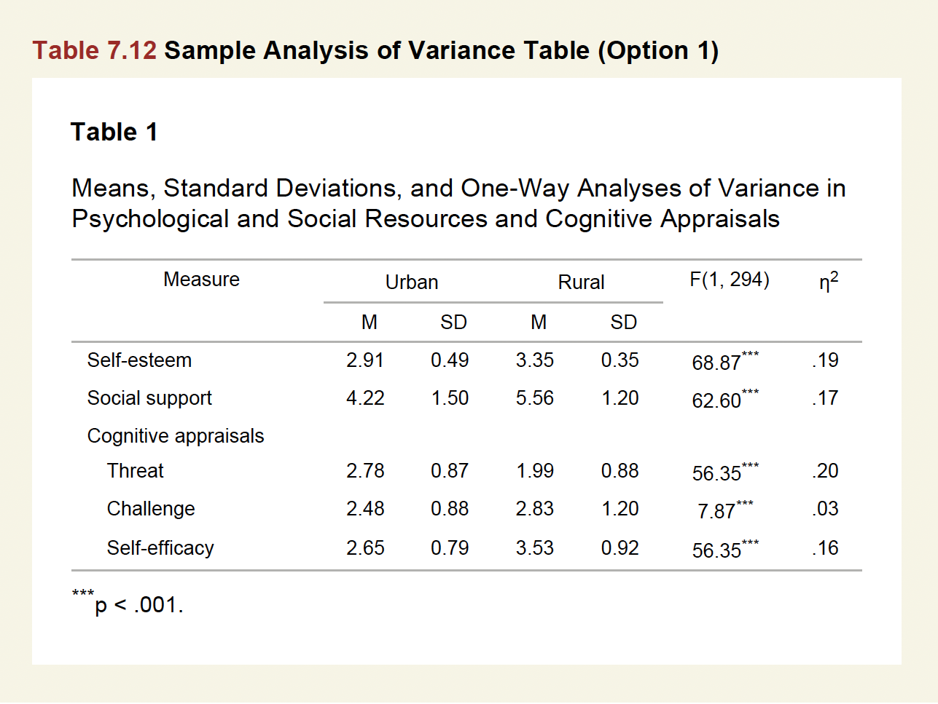
One way ANOVA
F statistics
Degree of freedom
Effect size or p value

Slide 34
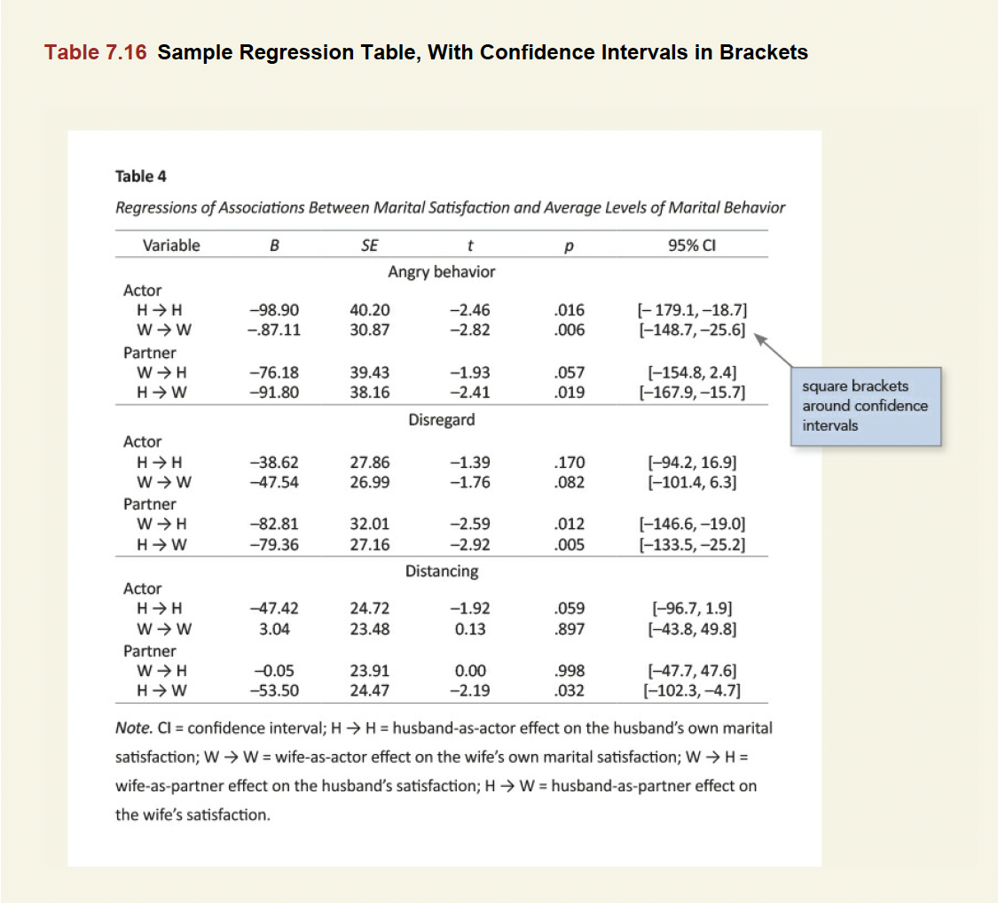
Regression table
Beta coefficient / Odds ratio
Standard error
t statistics
p value
Confidence interval

Slide 35
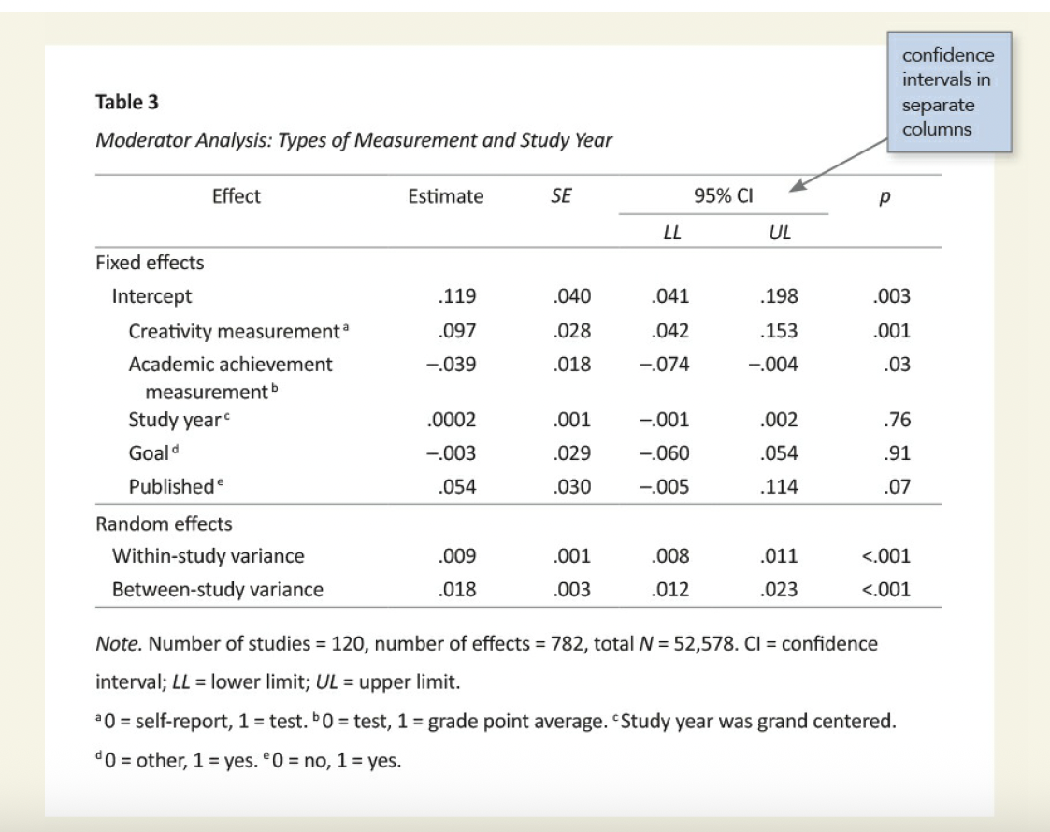
Regression table
Beta coefficient / OR
Standard error
t statistics
p value
Confidence interval
Use superscript lowercase letter italic

Slide 36
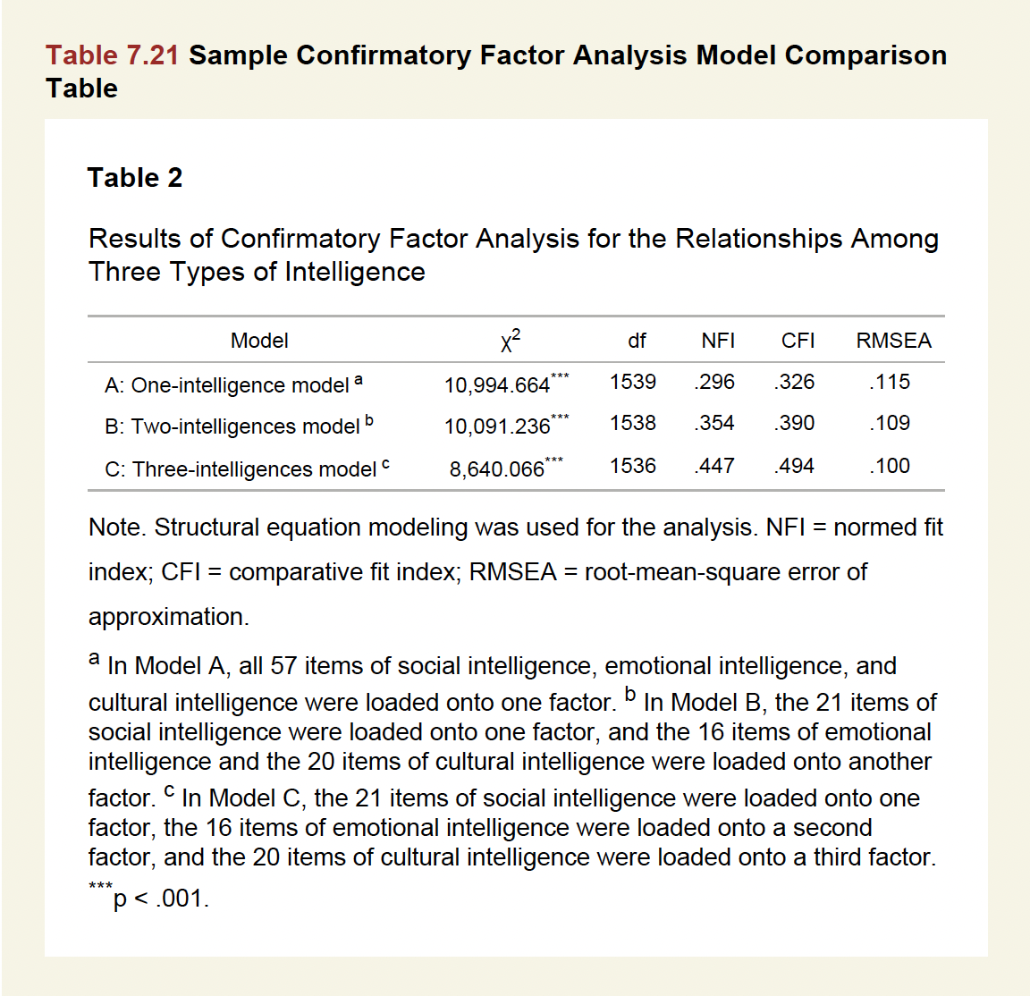
CONFIRMATORY FACTOR ANALYSIS (CFA)
Describe for each models
The model fit indices

Slide 37
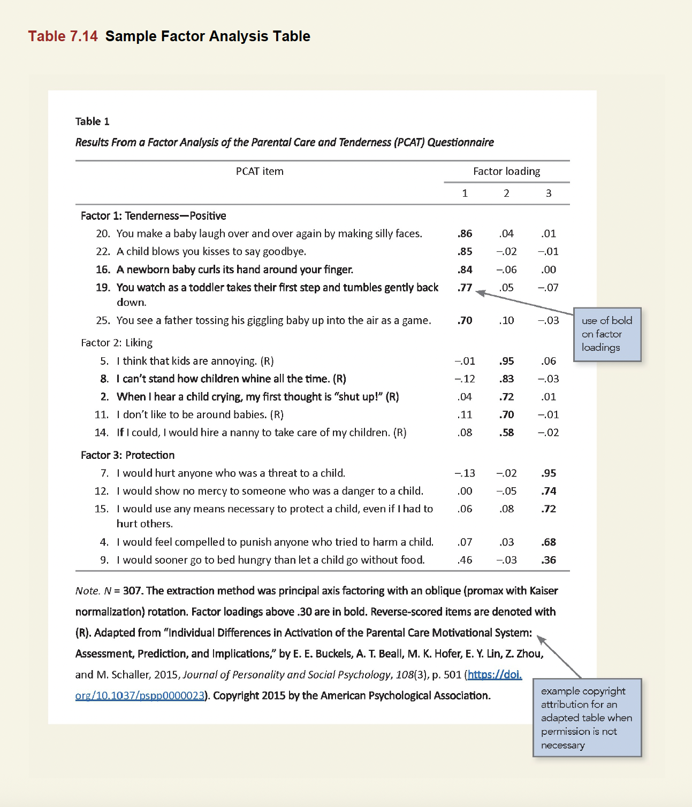
EXPLORATORY FACTOR ANALYSIS (EFA)
Present the factor loadings

Slide 38
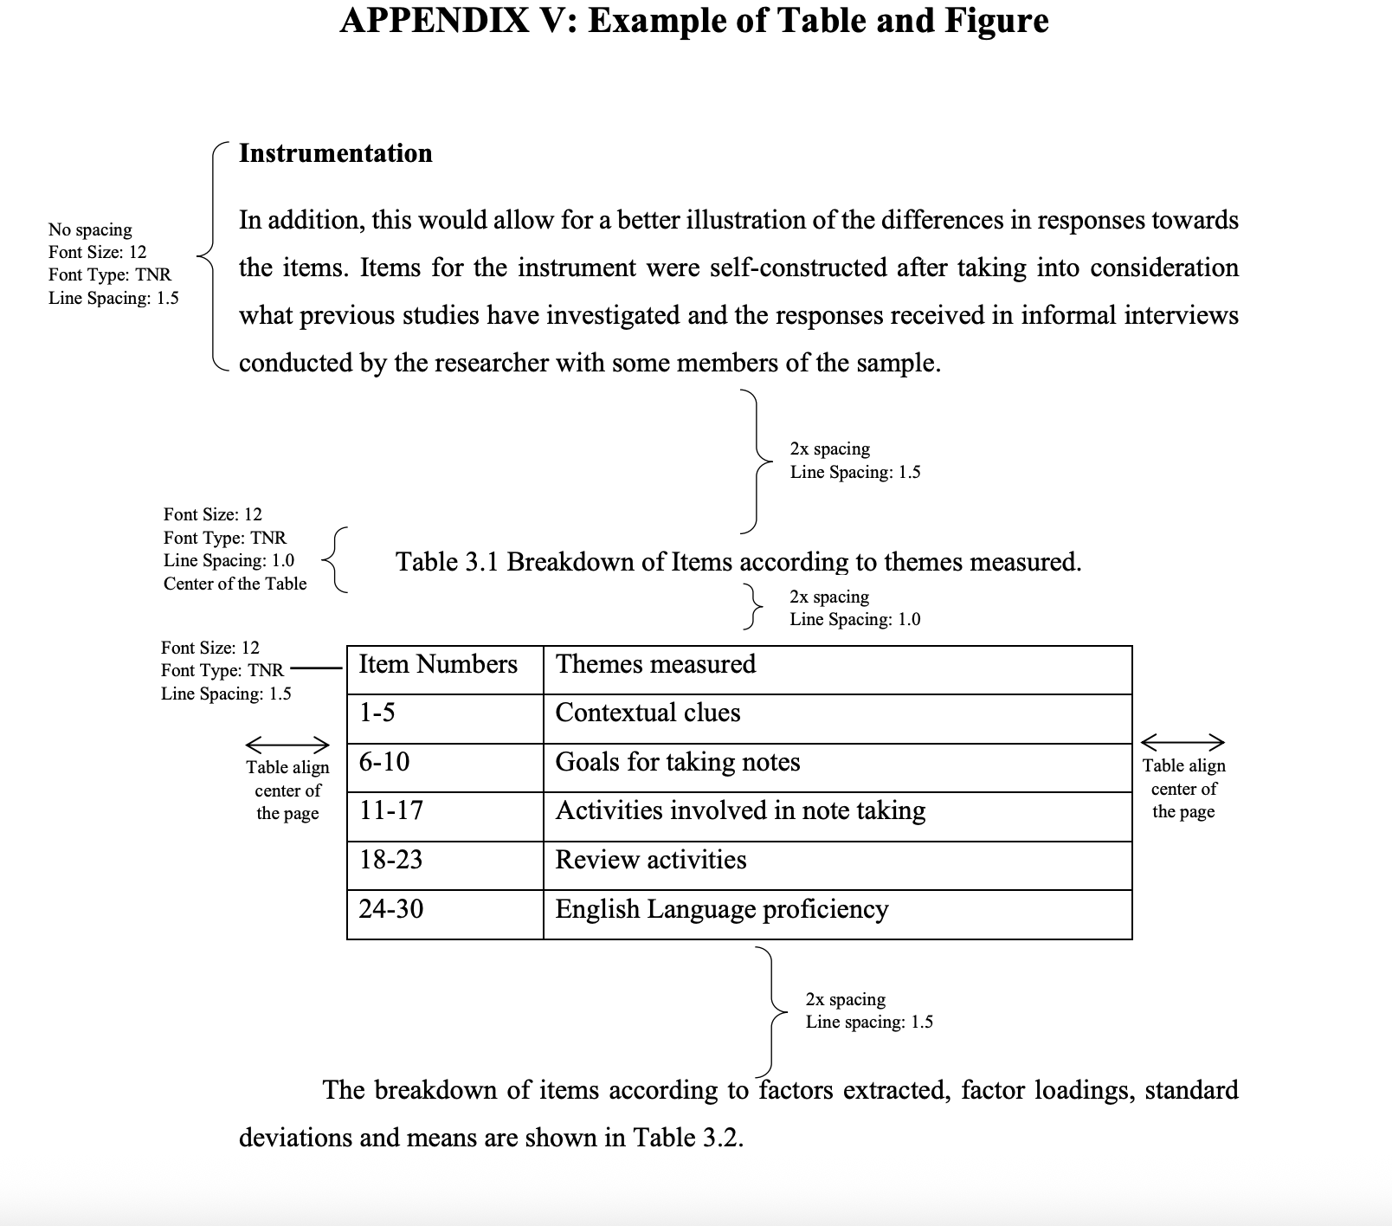
IIUM THESIS GUIDELINE (TABLE)
APA Table line rules
-Top line,Bottom line
-Line below column header
APA Table number bold but table title normal
Figure title top
IIUM Table line rules - all lines
Table number and title normal
1.5 spacing with double spacing after text and before text
1.0 spacing with double spacing after title
Figure title bottom
Table centred

Slide 39
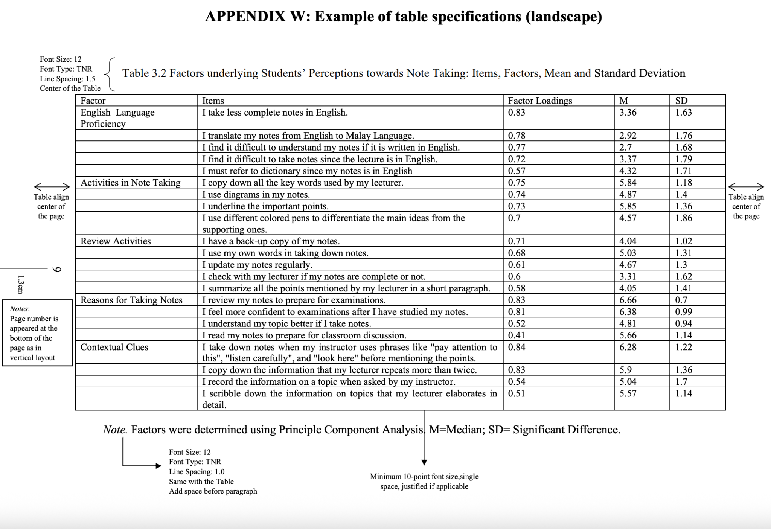

Slide 40

THANK YOU
Muhammad Adil ZA, Assoc Prof Dr
MBBS,PGDIS (IIUM) DLSHTM,MSc (Lon) MPH,DrPH (UPM) AM (Mal) FRSPH (UK)
Deputy Dean (Research, Innovation & Development), Kulliyyah of Medicine , IIUM adilza@iium.edu.my
Adjunct Professor, Universiti Islam Malaysia
Research Fellow, Faculty of Medicine, Universitas Muhammadiyah Yogyakarta muhammad.adil@umy.ac.id

